Slide 1
CIS CONTROL 12: BOUNDARY DEFENSE - III
BOUNDARY DEFENSE

Slide 2
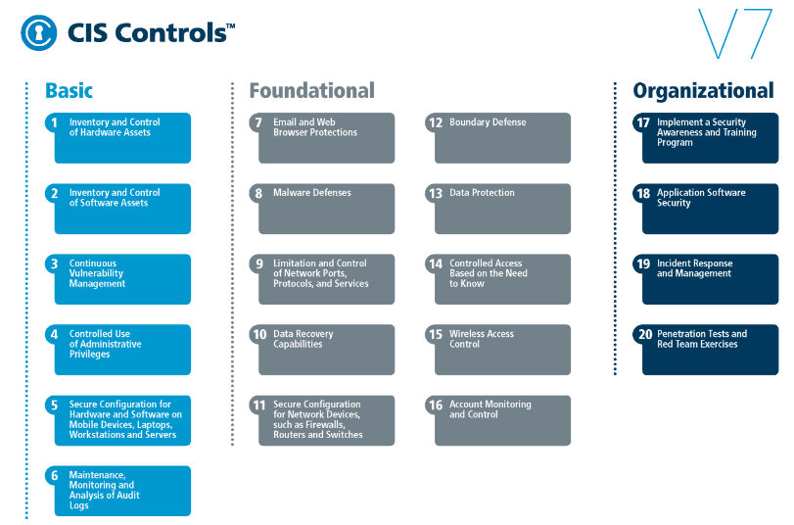
CIS CONTROL 12: BOUNDARY DEFENSE - III
https://www.cisecurity.org/controls/

Slide 3
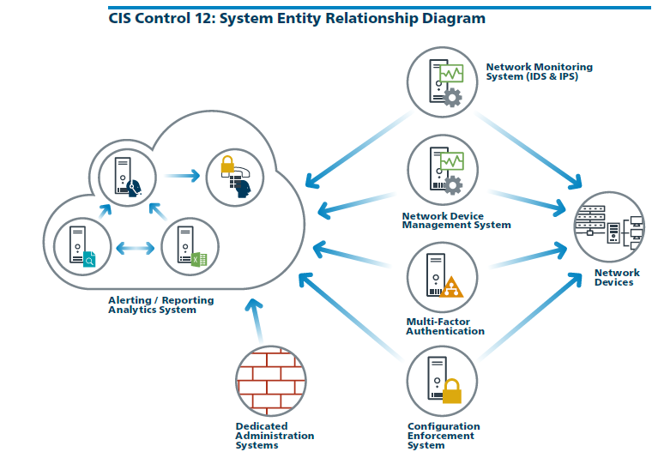
CIS CONTROL 12: BOUNDARY DEFENSE - III
https://www.cisecurity.org/controls/

Slide 4
CIS CONTROL 12: BOUNDARY DEFENSE - III
12.9: Deploy Application Layer Filtering Proxy Server
Ensure that all network traffic to or from the Internet passes through an authenticated application layer proxy that is configured to filter unauthorized connections.

Slide 5
CIS CONTROL 12: BOUNDARY DEFENSE - III
12.10: Decrypt Network Traffic at Proxy
Decrypt all encrypted network traffic at the boundary proxy prior to analyzing the content. However, the organization may use whitelists of allowed sites that can be…

Slide 6
CIS CONTROL 12: BOUNDARY DEFENSE - III
12.10: Decrypt Network Traffic at Proxy
…accessed through the proxy without decrypting the traffic.

Slide 7
CIS CONTROL 12: BOUNDARY DEFENSE - III
12.11: Require All Remote Login to Use Multi-factor Authentication
Require all remote login access to the organization's network to encrypt data in transit and use multi-factor authentication..

Slide 8
CIS CONTROL 12: BOUNDARY DEFENSE - III
12.12: Manage All Devices Remotely Logging into Internal Network
Scan all enterprise devices remotely logging into the organization's network prior to accessing the network to ensure that each of the organization's security…

Slide 9
CIS CONTROL 12: BOUNDARY DEFENSE - III
12.12: Manage All Devices Remotely Logging into Internal Network
…policies has been enforced in the same manner as local network devices.
END

